Slide 1
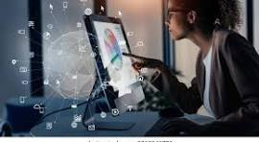
Welcome to information & communication technology
ICT in Business

Slide 2
INFORMATION
ICT is an essential part of modern business operations. It helps companies manage information , communicate effectively, mange data promote products and improve overall efficiency . ICT tools such as computers, internet and business software make work faster, easier, and more reliable.

Slide 3
Importance of ICT in Business
Operate more efficiently.
Reach customers worldwide
Reduce costs and save time
Improve communication and decision making
Enhance customer service and satisfaction

Slide 4

Communications
Major uses of ICT in business
ICT allows fast, easy and clear communication through emails, video conferencing, instant messaging apps and mobile phones.

Slide 5

ICT helps store, organize and protect large amounts of business data such as employee records, sales reports, and inventories.
Data management and record keeping

Slide 6
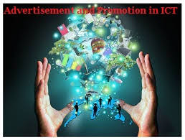
ICT supports digital marketing through website, social media and online advertisements.
Marketing & Advertisement

Slide 7
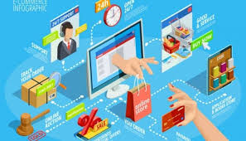
ICT enables online buying and selling goods and services, allowing business to reach global customer.
E-Commerce

Slide 8

FINANCIAL MANAGEMENT
ICT assists in managing accounts, online transactions, and payroll systems efficiently.

Slide 9

CUSTOMER SERVICE AND SUPPORT
ICT improves customer care through email, online chart, social media, and feedback systems.

Slide 10
Advantages of using ICT in business
Speeds up communication and data processing.
Expands market and reach globally.
Exchange productivity and teamwork.
Reduce paper usage and operational casts.
Improves customer relationship management.

Slide 11
Challenges of ICT in business
Cyber security risk and data theft.
High setup and maintenance cost.
Technical issues or system failures.
Need for staff training and updates.

Slide 12
Future of ICT in business
The future of business will depend even more on ICT through trends like Artificial Intelligence(AI), Cloud Computing, and Big Data.
These technologies will make decision-making smarter and business operations more automated.

Slide 13
CONCLUSION
ICT has completely changed the business world by improving communication, management and global reach. It helps business work efficiently, serve customer better, and stay competitive. In short, ICT is the backbone of modern business success.

